Slide 1
Traffic Accident Prediction
Capstone Project – marton molnar

Slide 2
Business Problem
Based on Seattle’s traffic accidents data we need to provide actionable items.
Who and how can utilize the findings of our predictions?
We expect to have an actionable list for the Seattle Police Department, Insurance companies ad real estate agents

Slide 3
The Data
Historical data of 190.000 accidents starting from 2014
Categorized by more than 40 aspects, like
Location (Geo coordinates, road type, objects)
Time
Environmental information (weather, lights)
Participants
Type and direction of collision

Slide 4
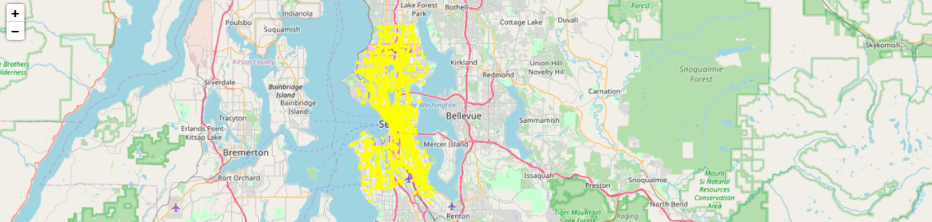
Data Analysis
Putting the data on map: location of accidents

Slide 5
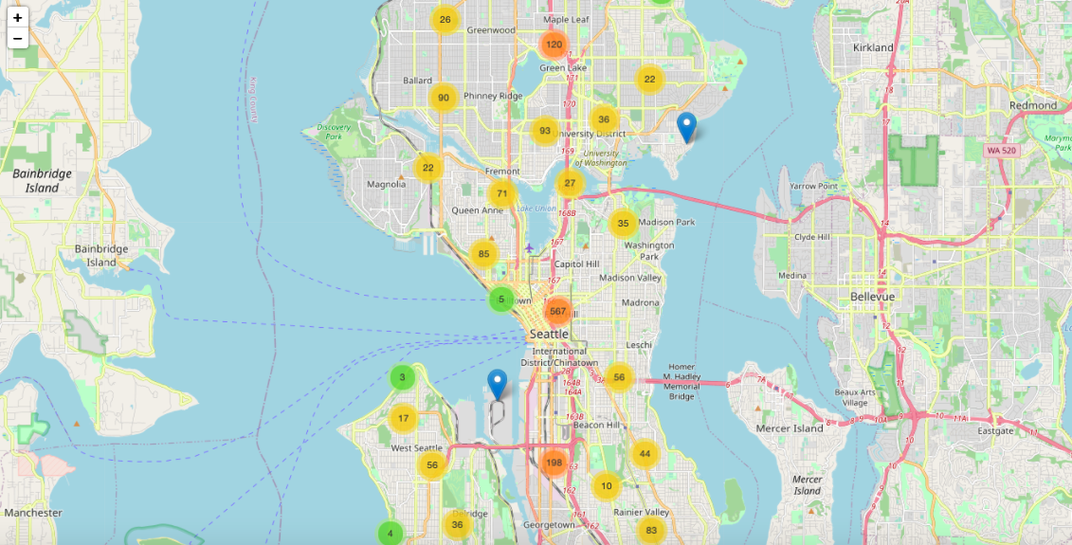
Data Analysis
Putting the data on map: location of accidents by clusters

Slide 6

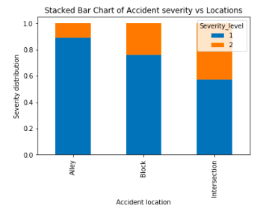
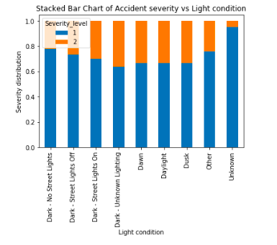
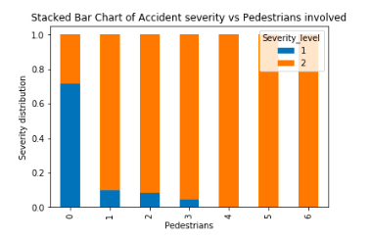
Data Analysis
Exploring data with graphs, finding relevant insights

Slide 7
Machine learning: model
Choice of model: Logistic regression
as we have two types of output, this is a categorization
several independent variables are affecting a single outcome variable
we are looking for a probabilistic result
we need to know the impact of a feature

Slide 8
Machine learning: implementation
Features
Location_type
Collision_type
Inattention
Under_influence
Weather
Road_condition
Light_condition
Pedestrian_right
Speeding
Outcome
Severity_level
Transformations
Removing missing data rows
Reducing feature categories
Using OneHotEncoder to convert String values to Integers

Slide 9
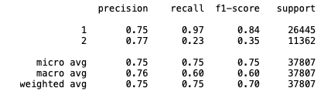
Machine learning: classification report

Slide 10
Summary
Data analysis processed
Data transformation implemented to clean up and sanitize data
Logistic Regression model has been built on a training set and verified on test set
Conclusions:
Geographical impacts on the accidents
Most dangerous locations identified
Most dangerous daytimes identified
Impact of the severe accidents identified

